Slide 1
IOT BASED RESPIRATION MONITORING SYSTEM

Slide 2
ABSTRACT
Asthma and other respiratory conditions are chronic and affect a person's breathing. Respiratory illnesses are the third leading cause of death, and pose a significant burden on the patients, carers and medical services worldwide. The lungs of a person with asthma undergoes deterioration. Children above age five, and adults, who have asthma-like symptoms should have a spirometry test. The spirometers used in hospitals are bulky, expensive, complex to use and are therefore inaccessible to a majority of places, most likely rural areas, causing the patients to travel long distances to undergo the testing.

Slide 3
INTRODUCTION
In the recent years wireless technology has increasing for the need of upholding various sectors.In these recent years IoT graped the most of industrial area specially automation and control. Biomedical is one of recent trend to provide better health care. Not only in hospitals but also the personal health caring facilities are opened by the IoT technology. So having a smart system various parameters are observed that consumes power, cost and increase efficiency.

Slide 4
EXISTING SYSTEM
In traditional method, doctors play an important role in health check up. For this process requires a lot of time for registration, appointment and then check up. Also reports are generated later. Due to this lengthy process working people tend to ignore the check ups or postpone it. This modern approach reduces time consumption in the process.

Slide 5
DISADVANTAGES
This process requires a lot of time for registration, appointment and then check up. Also reports are generated later. Due to this lengthy process working people tend to ignore the check-ups or postpone it.

Slide 6
PROPOSED SYSTEM
The main vital signs to be routinely tested by medical professionals include: Breathing rate, Pulse rate, & Body temperature. These signs help detect & monitor medical problems, & totally affect each other. For eg, with rise in body temperature, respiratory rate also increases. Thus, this project utilizes three different sets of sensors to detect all three signs, and describes the design of a simple, low-cost IOT based patient health monitoring system.
This setup uses Arduino Nano as the heart of the project. With the help of ESP8266, a Wi-Fi module, all the data about the patient’s health will reach the doctors located remotely in cities and health centres, and decisions will be taken after real-time analysis with the help of Nodemcu.

Slide 7
ADVANTAGES
1)Doctors to monitor patients remotely without risk of infection
2)Sensing and Data collection
3)Tracking an patient
The System was High efficient to access their data’s in cloud.
Anywhere and anytime we can monitor the patient by their data’s through to IOT Cloud.

Slide 8
BLOCK DIAGRAM
CO2 SENSOR
ARDUINO
UNO
LCD DISPLAY
RESPIRATORY SENSOR
NODEMCU
BLOOD PRESSURE SENSOR
IOT/WEB PAGE
POWER SUPPLY
ALCOHOL SENSOR
BUZZER

Slide 9
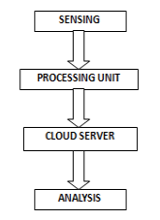
WORKING MODULE
The health monitoring sensors are used to collect health related data i.e. for data acquisition. Communication can be done by controller for sending data on internet wirelessly. Data processing has been done at server. All data collected and aggregated at server point. To get health related information in understandable format it can be shown on web page i.e. data management.

Slide 10
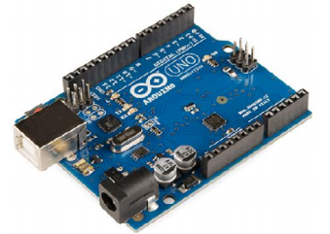
ARDUINO UNO
Arduino Uno is a microcontroller board based on the ATmega328. It has 14 digital input / output pins (of which 6 can be used as PWM outputs), 6 analog inputs, 16 MHz ceramic resonator, USB connection, power jack, ICSP plug, and a reset button. It contains everything needed to support the microcontroller; simply use the USB cable or power it with a AC-to-DC adapter or battery is connected to a computer begins.

Slide 11
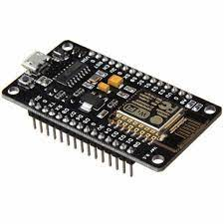
ESP8266
The ESP8266 WiFi Module is a self contained SOC with integrated TCP/IP protocol stack that can give any microcontroller access to your WiFi network.
The ESP8266 is capable of either hosting an application or offloading all WiFi networking functions from another application processor.
Each ESP8266 module comes pre-programmed with an AT command set firmware, meaning, you can simply hook this up to your Arduino device and get about as much WiFi-ability as a WiFi Shield offers
Built-in temperature sensor, Support antenna diversity, off leakage current is less than 10uA
Built-in low-power 32-bit CPU: can double as an application processor, SDIO 2.0, SPI, UART

Slide 12
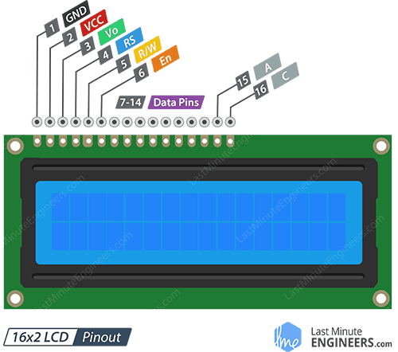
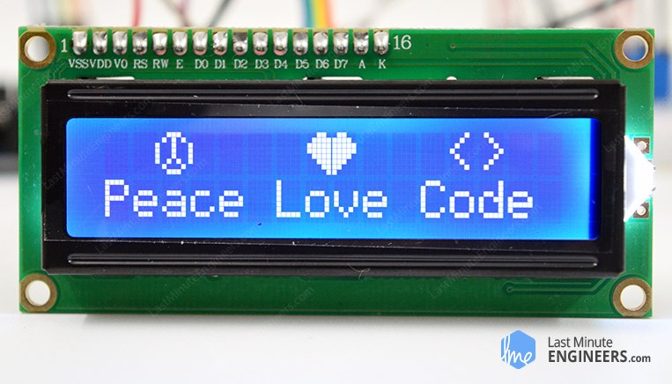
16 * 2 LCD DISPLAY
These LCDs are ideal for displaying text/characters only, hence the name ‘Character LCD’. The display has an LED backlight and can display 32 ASCII characters in two rows with 16 characters on each row.
Although they display only text, they do come in many sizes and colors: for example, 16×1, 16×4, 20×4, with white text on blue background, with black text on green and many more.

Slide 13
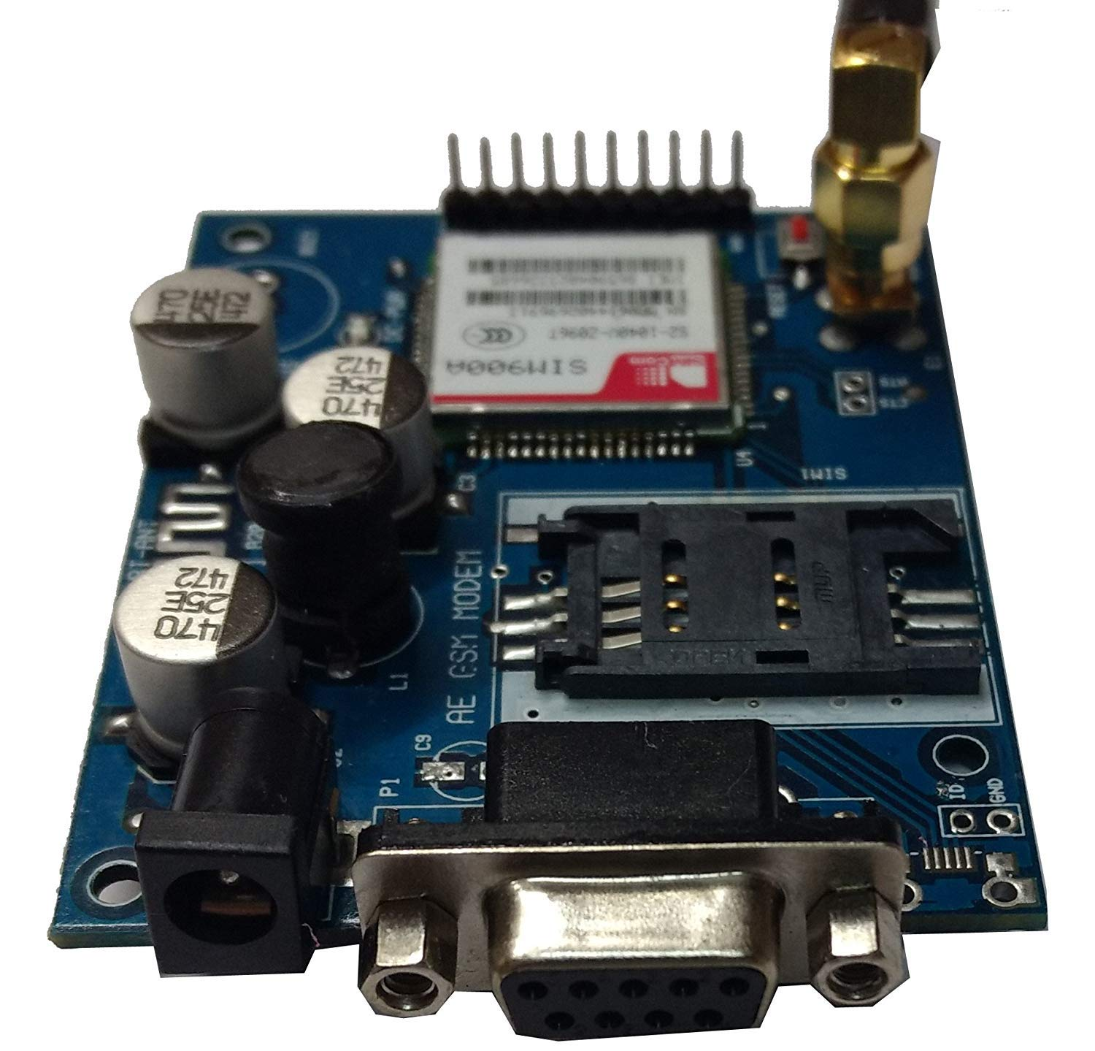
GSM
GSM (Global System for Mobile Communications, originally Groupe Special Mobile), is a standard developed by the European Telecommunications Standards Institute.
It was created to describe the protocols for second-generation digital cellular networks used by mobile phones and is now the default global standard for mobile communications – with over 90% market share, operating in over 219 countries and territories.

Slide 14
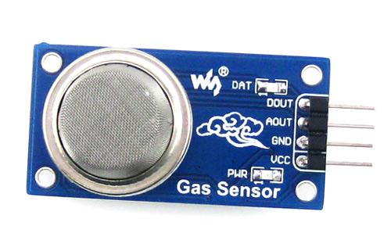
MQ-2 GAS SENSOR
The MQ-2 Gas sensor can detect or measure gasses like LPG, Alcohol, Propane, Hydrogen, CO and even methane. The module version of this sensor comes with a Digital Pin which makes this sensor to operate even without a microcontroller and that comes in handy when you are only trying to detect one particular gas. When it comes to measuring the gas in ppm the analog pin has to be used, the analog pin also TTL driven and works on 5V and hence can be used with most common microcontrollers.
So if you are looking for a sensor to detect or measure gasses like LPG, Alcohol, Propane, Hydrogen, CO and even methane with or without a microcontroller then this sensor might be the right choice for you.

Slide 15
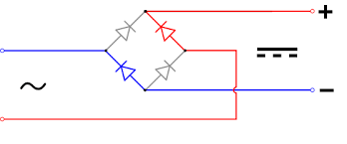
TRANSFORMER
0-12 5Amp Step Down Transformer is a general purpose chassis mounting mains transformer. Transformer has 230V primary winding and non-center tapped secondary winding. The transformer has flying colored insulated connecting leads ( Approx 100 mm long ). The Transformer act as step down transformer reducing AC - 230V to AC - 12V.
The Transformer gives outputs of 12V and 0V. The Transformer's construction is written below with details of Solid Core and Winding.
The transformer is a static electrical device that transfers energy by inductive coupling between its winding circuits.
A varying current in the primary winding creates a varying magnetic flux in the transformer's core and thus a varying magnetic flux through the secondary winding.

Slide 16
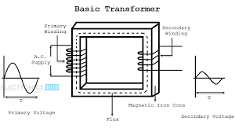
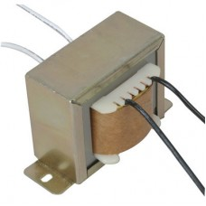
This varying magnetic flux induces a varying electromotive force (E.M.F) or voltage in the secondary winding. The transformer has cores made of high permeability silicon steel.
The steel has a permeability many times that of free space and the core thus serves to greatly reduce the magnetizing current and confine the flux to a path which closely couples the winding.

Slide 17
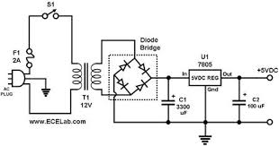
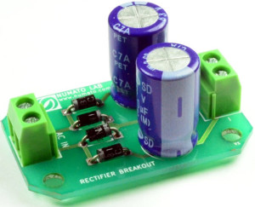
BRIDGE RECTIFIER
A Bridge rectifier is an Alternating Current (AC) to Direct Current (DC) converter that rectifies mains AC input to DC output.
Bridge Rectifiers are widely used in power supplies that provide necessary DC voltage for the electronic components or devices.
They can be constructed with four or more diodes or any other controlled solid-state switches.
We can find this rectifier in a wide variety of electronic AC power devices like home appliances, motor controllers, modulation process, welding applications, etc.

Slide 18
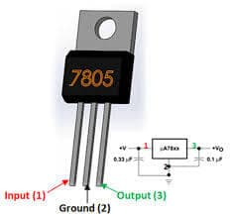
IC 7805 VOLTAGE REGULATOR
it is a three-pin IC; input pin for accepting incoming DC voltage, ground pin for establishing ground for the regulator, and output pin that supplies the positive 5 volts.
Input Voltage: Minimum 7V, Maximum 25V
Output Current: 1.5A
Operating Virtual Junction Temperature: Minimum 0, Maximum 125°C
Possible High Temperatures
If differences between the input and output voltages are not well managed, LM7805 can overheat, which may result in malfunctioning. Solutions Include:
Limiting input voltage to 2-3 volts above the output regulated voltage
Placing a heat sink in the circuit to dissipate heat solutions

Slide 19
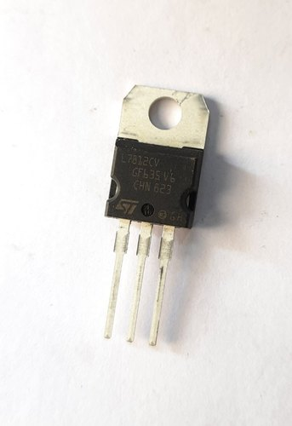
IC 7812 VOLTAGE REGULATOR
LM7812 is a TO-220 packaged positive voltage regulator IC of LM78xx series that is manufactured by many different electronic components manufacturers.
The IC provides fixed 12V output voltage no matter if the input voltage is fluctuating or changing continuously or it is higher than 12V but the input voltage should not be more than 35V which is the maximum input voltage limit this IC is capable to handle.
Moreover the input voltage should not be less than 14V that is the minimum input voltage requirement of the IC to provide fixed 12V output.
During usage when the IC performing voltage regulation or stepping down the input voltage all the voltage difference between the input voltage and the output is converted to heat due to which a suitable heatsink is mandatory for proper working of the IC.
The IC can handle maximum load of 1A to 1.5A but the input current should be 2A to get 1A to 1.5A at the output.

Slide 20
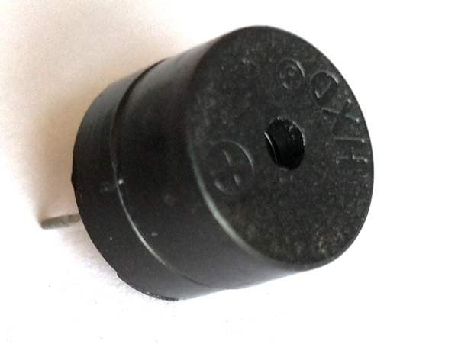
BUZZER
A buzzer is a small yet efficient component to add sound features to our project/system. It is very small and compact 2-pin structure hence can be easily used on breadboard, Perf Board and even on PCBs which makes this a widely used component in most electronic applications.
There are two types are buzzers that are commonly available. The one shown here is a simple buzzer which when powered will make a Continuous Beeeeeeppp.... sound, the other type is called a readymade buzzer which will look bulkier than this and will produce a Beep. Beep. Beep. Sound due to the internal oscillating circuit present inside it. But, the one shown here is most widely used because it can be customised with help of other circuits to fit easily in our application.

Slide 21
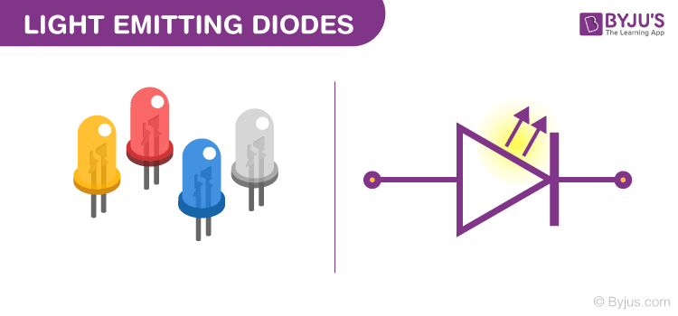
LED
A Light Emitting Diode (LED) is a semiconductor device, which can emit light when an electric current passes through it. To do this, holes from p-type semiconductors recombine with electrons from n-type semiconductors to produce light.
The wavelength of the light emitted depends on the bandgap of the semiconductor material. Harder materials with stronger molecular bonds generally have wider bandgaps. Aluminum Nitride semiconductors are known as ultra-wide bandgap semiconductors.

Slide 22
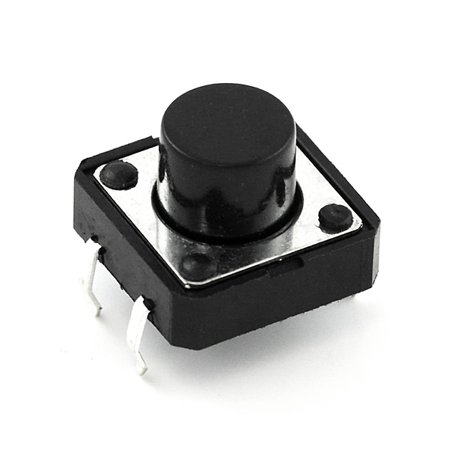
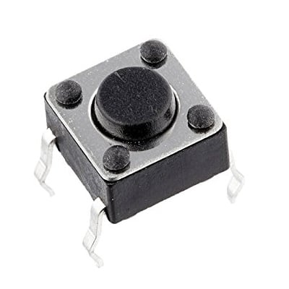
PUSH BUTTON
A push-button (also spelled pushbutton) or simply button is a simple switch mechanism to control some aspect of a machine or a process. Buttons are typically made out of hard material, usually plastic or metal.
There are two types of Durakool Momentary Push Button Switches: 'Push to Make' and 'Push to Break'. A momentary 'push to make' switch allows the electricity flow between its two contacts while the button is depressed.

Slide 23
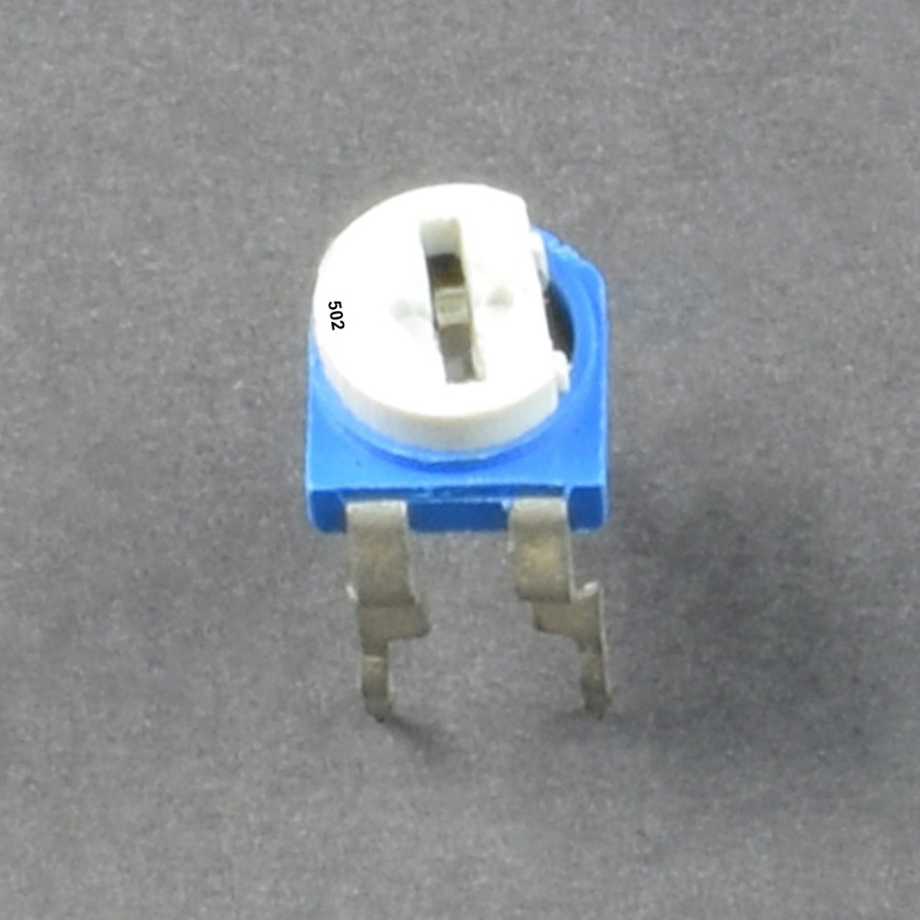
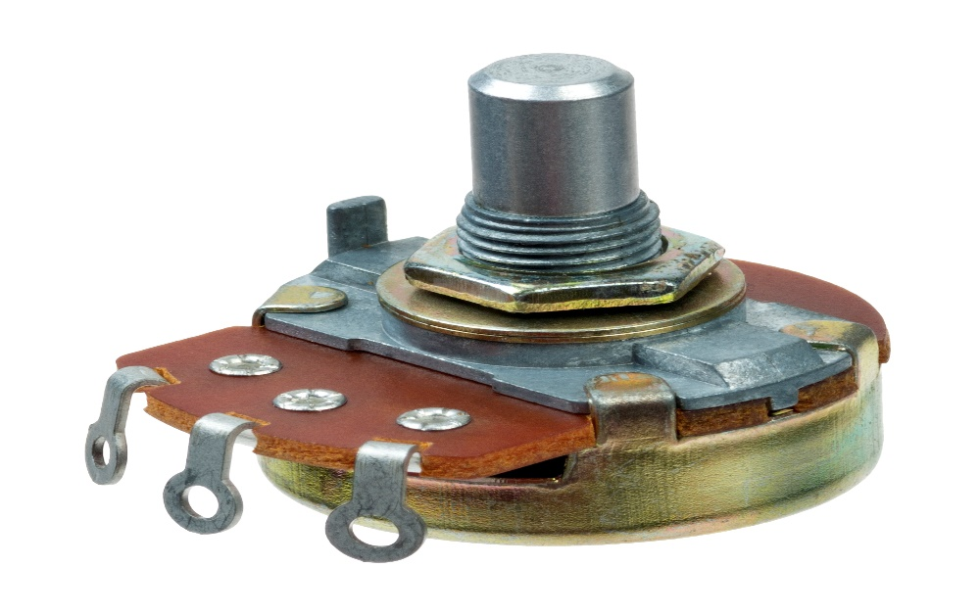
POTENTIOMETER
A potentiometer is a type of position sensor. They are used to measure displacement in any direction. Linear potentiometers linearly measure displacement and rotary potentiometers measure rotational displacement.
The potentiometer is a simple device used to measure the electrical potentials (or compare the e.m.f of a cell)
The balancing point or null point of the potentiometer is the point on the slide wire when the galvanometer shows zero deflection. The balance point is found to determine the unknown voltage of the cell connected to the cell.

Slide 24
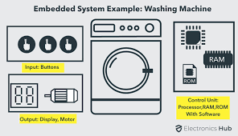
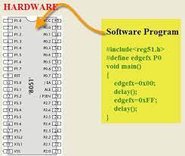
EMBEDDED C PROGRAMMING LANGUAGE
C language is software designed with different keywords, data types, variables, constants, etc.
Embedded C is a generic term given to a programming language written in C, which is associated with a particular hardware architecture.
Embedded C is an extension to the C language with some additional header files. These header files may change from controller to controller.
The microcontroller 8051 #include<reg51.h> is used.

Slide 25
ARDUINO IDE
The Arduino Integrated Development Environment (IDE) is a cross-platform application (for Windows, macOS, Linux) that is written in functions from C and C++.
It is used to write and upload programs to Arduino compatible boards, but also, with the help of third-party cores, other vendor development boards.
The source code for the IDE is released under the GNU General Public License, version 2. The Arduino IDE supports the languages C and C++ using special rules of code structuring.
The Arduino IDE supplies a software library from the Wiring project, which provides many common input and output procedures.
User-written code only requires two basic functions, for starting the sketch and the main program loop, that are compiled and linked with a program stub main() into an executable cyclic executive program with the GNU toolchain, also included with the IDE distribution.

Slide 26

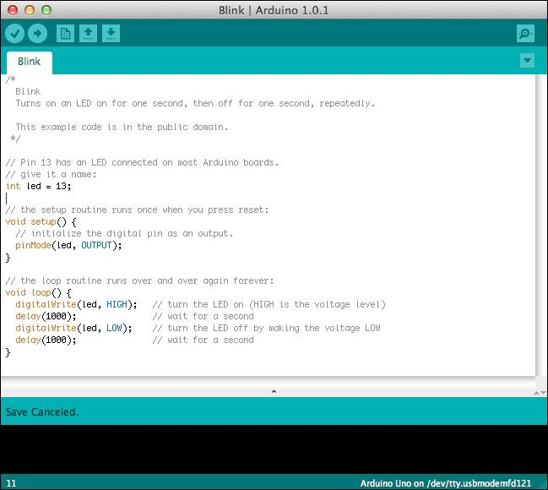

Slide 27

IOT PAGE
The Internet of Things, or IoT, refers to the billions of physical devices around the world that are now connected to the internet, all collecting and sharing data.
Thanks to the arrival of super-cheap computer chips and the ubiquity of wireless networks, it's possible to turn anything, from something as small as a pill to something as big as an aero plane, into a part of the IoT.
Connecting up all these different objects and adding sensors to them adds a level of digital intelligence to devices that would be otherwise dumb, enabling them to communicate real-time data without involving a human being.
The Internet of Things is making the fabric of the world around us more smarter and more responsive, merging the digital and physical universes.

Slide 28
APPLICATIONS
APPLICATIONS
Used in hospitals
Used by people who are incapacitated or confined to bed
People suffering from speech disabilities, stroke, brain injuries

Slide 29
CONCLUSION
The results obtained from different sensor devices will be compared and analysed in detail. The values are recorded using sensors and processed using microcontroller. For emergency send the message to doctor .This system is low cost, self-monitoring device and used in remote areas efficiently. The health details of the patients is send to patient’s caretakers mobile phones via SMS using GSM modem. A new architecture for IOT health monitoring which provides security at the communication link as well as by providing user authentication.

Slide 30
REFERENCES
1. Ebrahim Al Alkeem1, Dina Shehada1, Chan Yeob Yeun1,M. Jamal Zemerly ,Jiankun Hu “New secure healthcare system using cloud of things”, Springer Science+Business Media New York 2017
2. Yena Kim, SeungSeob Lee and SuKyoung Lee “Coexistence of ZigBee-based WBAN and WiFi for Health Telemonitoring Systems” , DOI 10.1109/JBHI.2014.2387867, IEEE Journal of Biomedical and Health Informatics
3. Mirza Mansoor Baig & Hamid Gholamhosseini “Smart Health Monitoring Systems: An Overview of Design and Modeling”, Springer Science+Business Media New York 2013

